Slide 1

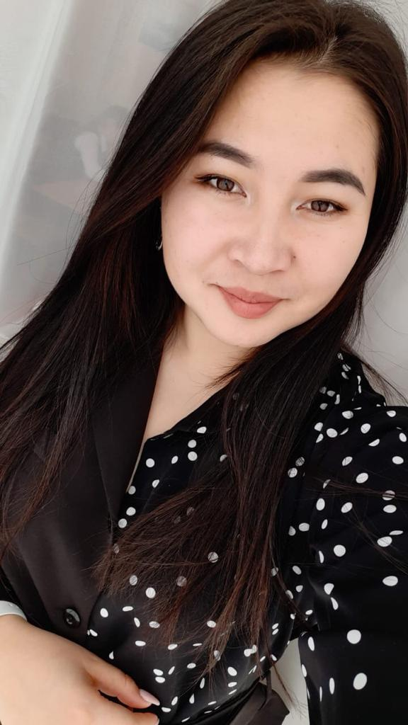
The teacher of English
Maguazova Zhansaya Bakytovna

Slide 2
The 26th of October.

Slide 3
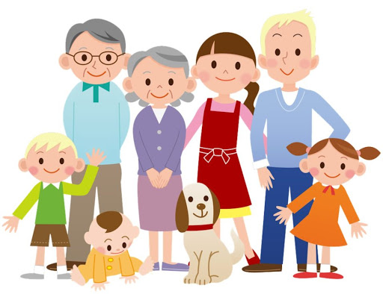
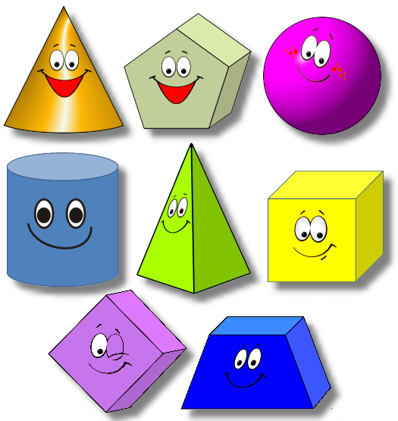
Famous figures
’’’
+
+
s
ous

Slide 4


Slide 5
The topic of the lesson:
“Famous figures”
Lesson objectives:
- practice pronunciation with new words in the text
- apply topical vocabulary to talk about famous figures.

Slide 6
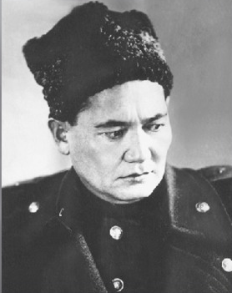

Slide 7
New words:
Educated
Rural
Military
Leader
Include
Brave
Образованный
Сельский
Военный
Лидер
Включать в (себя)
Храбрый

Slide 8


Slide 9
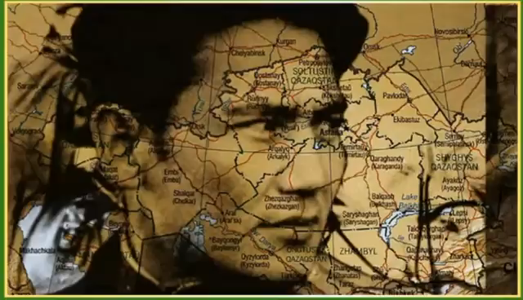
Descriptor: Answer the questions and define specific information of the video
Assessment criteria: understand specific text information

Slide 10
Descriptors:
*answer the questions
*defines specific information
Bauyrzhan Momyshuly
Bauyrzhan Momyshuly was born in Mynbulak village in Zhambyl region in 1910. He was very educated. Bauyrzhan began working as a rural policeman, but after a few years he joined the army and became a military leader. He fought in many battles and was famous for his bravery. Bauyrzhan wrote several books including One Night’s Tale and Moscow is Behind Us. To this day, people remember him as a People’s Hero of Kazakhstan.
(page 25)

Slide 11
Descriptors:
*describe the heroes
*compusing new vocabulary
Bauyrzhan Momyshuly

Slide 12
Descriptors:
*describe the heroes
*compusing new vocabulary
Leader
Brave
Hero
Bauyrzhan Momyshuly
Wrote several books
Educated
Rural policeman

Slide 13


Slide 14
Descriptors:
*Choose the correct answer
*Check yourself
TEST
Baurzhan Momyshuly was ……
A brave hero
A singer
An actor
2) When was he born?
1975
1870
1910
3) Baurzhan Momyshuly began working as a ……
Leader
Rural policeman
actress

Slide 15
:
4) Where was he born?
Los Angeles
Charity
Minbulak village Zhambyl region
He was famous for his …..
Bravery
Mind
Success

Slide 16
CHECK YOUR TEST
a
c
b
c
a

Slide 17


Slide 18
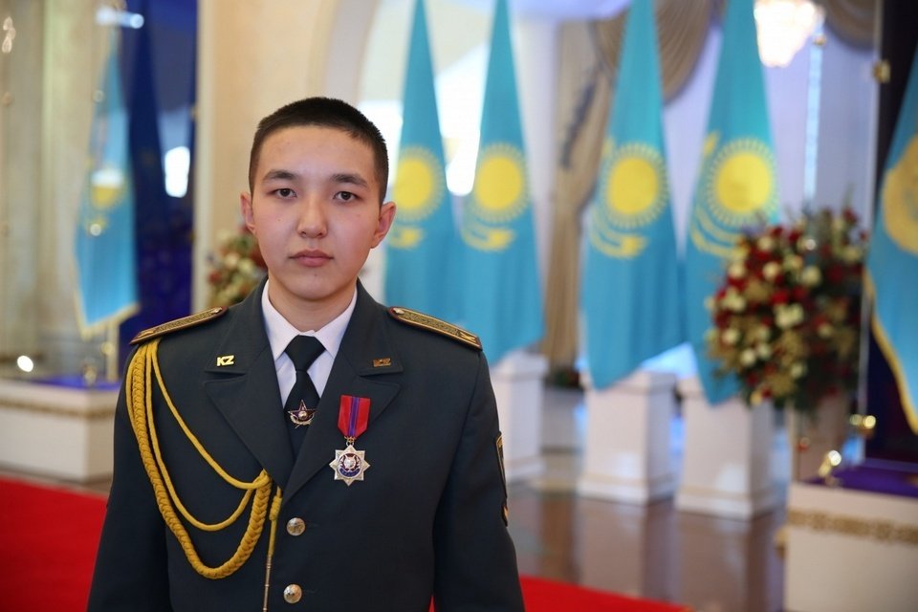
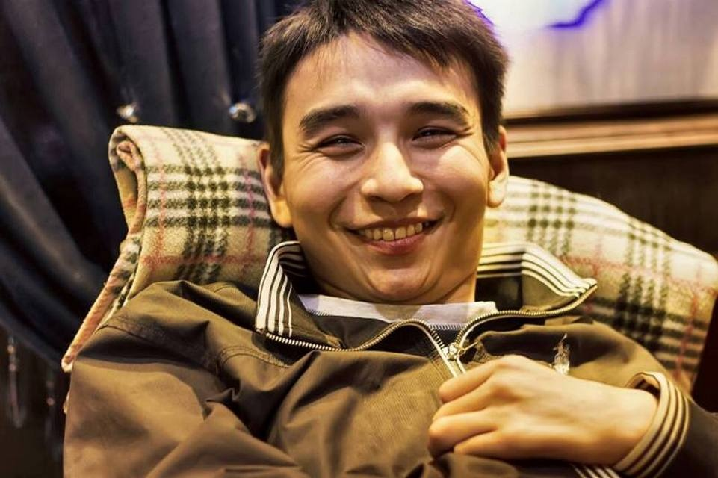
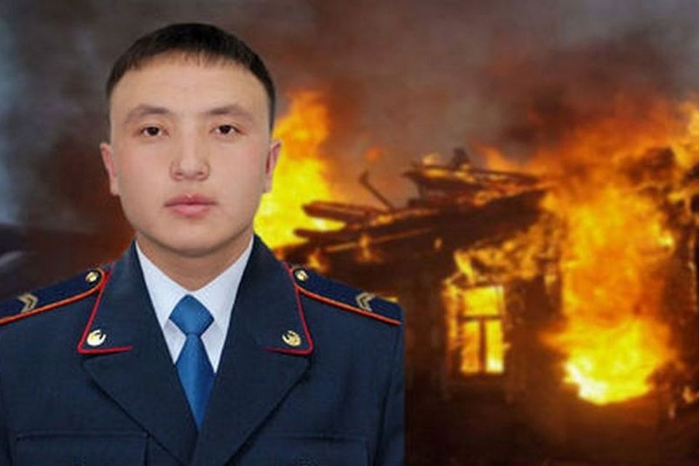
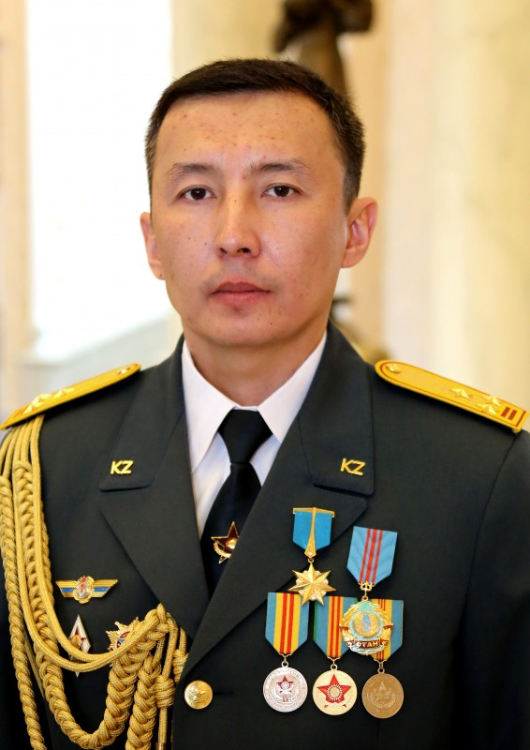
Бахтияр Кайырбеков
Нияз Сундиталиев
Данияр Аманжол
Кайрат Умбетов

Slide 19
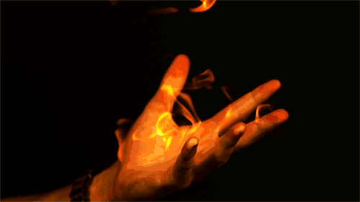

Slide 20
The lesson is over !!!
Good bye!

