Slide 1
By the sea

Slide 2
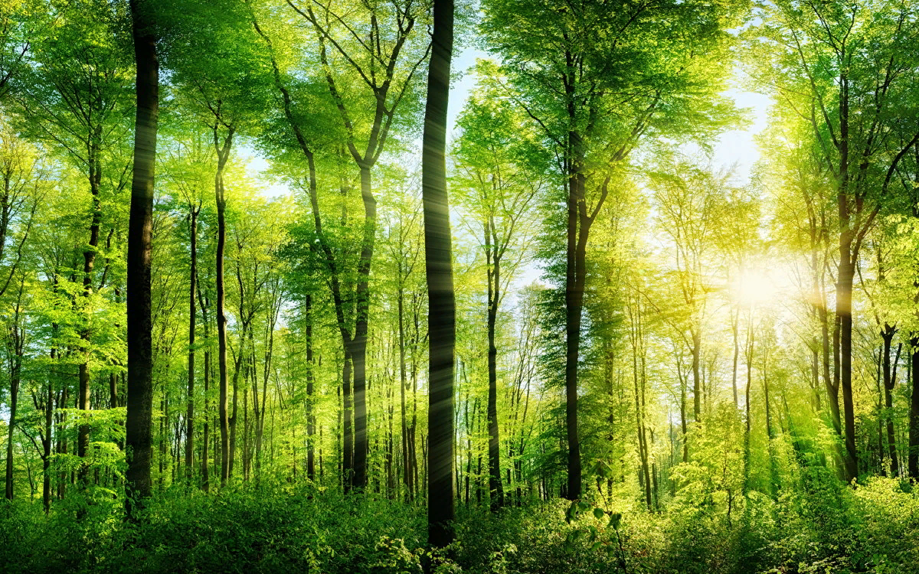
Forest

Slide 3
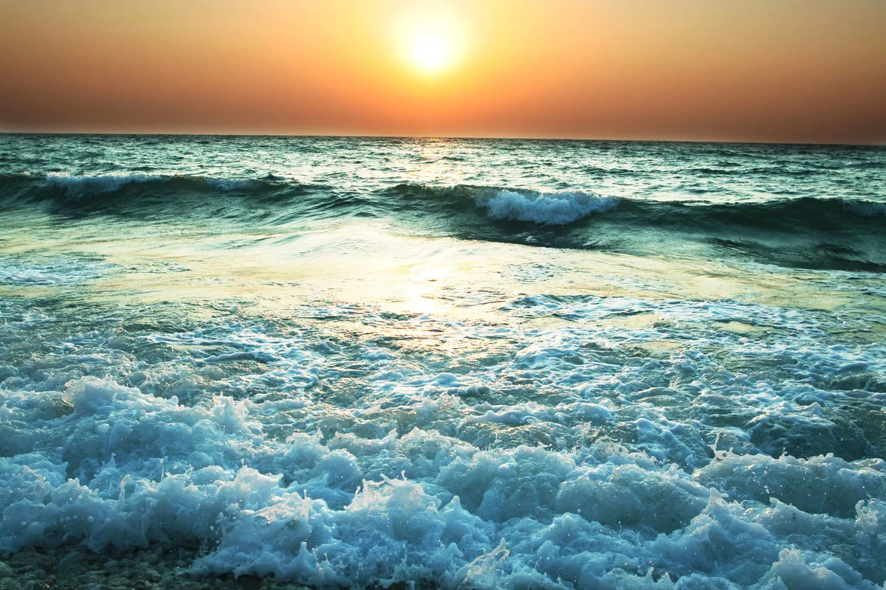
Sea

Slide 4
Plant

Slide 5
Tree

Slide 6
Ocean

Slide 7
Sun

Slide 8
Umbrella

